Slide 1




SMART ATTENDANCE SYSTEM USING OPENCV
Burra Soundarya
Mutapelli Himavarshitha
Ambatla Sruthika
Under the Trainer of,
MR.SUMIT SARTALE

Slide 2

PROJECT OBJECTIVES
Problem Statement
Project Overview – Introduction
End Users
Wow Factor in Project
Modelling/Block Diagram/Flow of Project
Result
Conclusion
Future Perspective

Slide 3


PROBLEM STATEMENT
The Smart Attendance System using OpenCV aims to address the challenges of traditional attendance tracking methods, which are often time-consuming, prone to errors, and susceptible to proxy attendance.
By leveraging facial recognition technology, this system seeks to automate the attendance process, allowing for real-time identification of individuals through a webcam feed.

Slide 4
PROJECT OVERVIEW - INTRODUCTION
The system consists of a user-friendly graphical interface built with Tkinter, allowing users to register, log in, and log out seamlessly.
Key features of the system include real-time face recognition through a webcam, which continuously captures video frames to identify registered users.
The system also incorporates a spoof detection mechanism to differentiate between genuine users and potential impersonators, enhancing security. Additionally, the system maintains a log of user activities, recording timestamps for attendance records.
The Smart Attendance System aims to reduce administrative burdens, improve accuracy, and foster a more accountable environment in educational and professional settings. Ultimately, this project seeks to revolutionize attendance tracking by providing a reliable, efficient, and user-friendly solution.

Slide 5
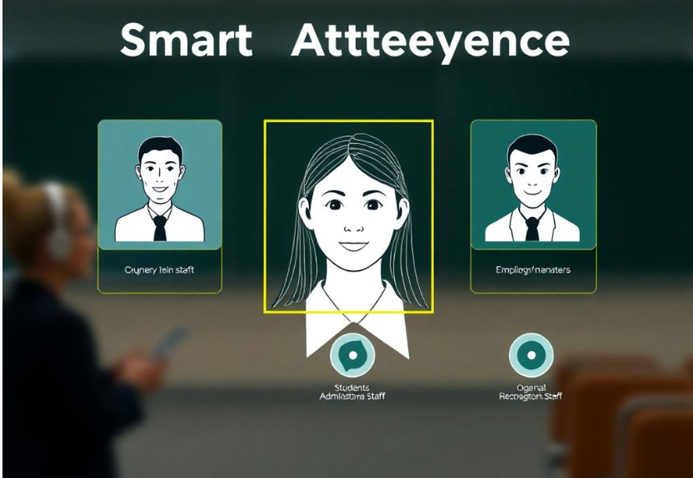
End User
Students
Administrative Staff
Employers/Managers

Slide 6
WOW FACTOR IN SOLUTION
We can incorporate several innovative features and enhancements that not only improve functionality but also create a more engaging and impressive user experience. Here are some ideas:
User Registration:
New users can easily register by capturing their facial images. The system processes these images to generate unique facial embeddings, which are securely stored for future recognition.
Spoof Detection Mechanism:
The system includes a basic framework for detecting spoofing attempts, such as photographs or videos. This feature enhances security by ensuring that only legitimate users can log in.
User -Friendly Interface:
Built with Tkinter, the application features an intuitive graphical user interface that simplifies interactions for students and administrators. Users can easily navigate through login, logout, and registration processes.

Slide 7
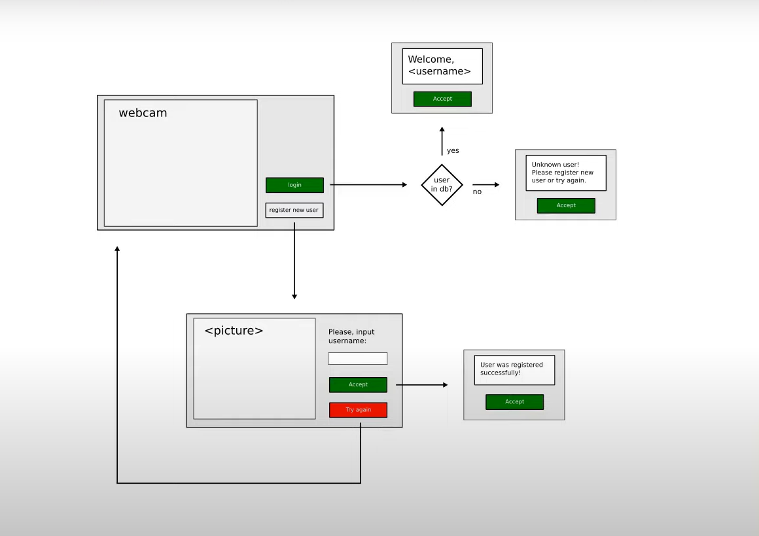
Modelling

Slide 8
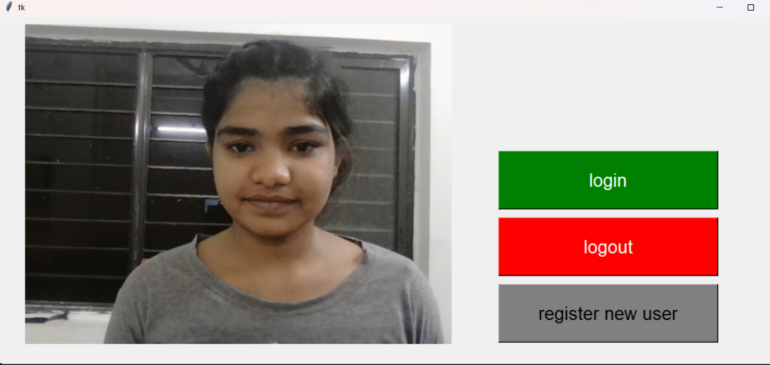
Result
1. Capturing The Image Of The User

Slide 9
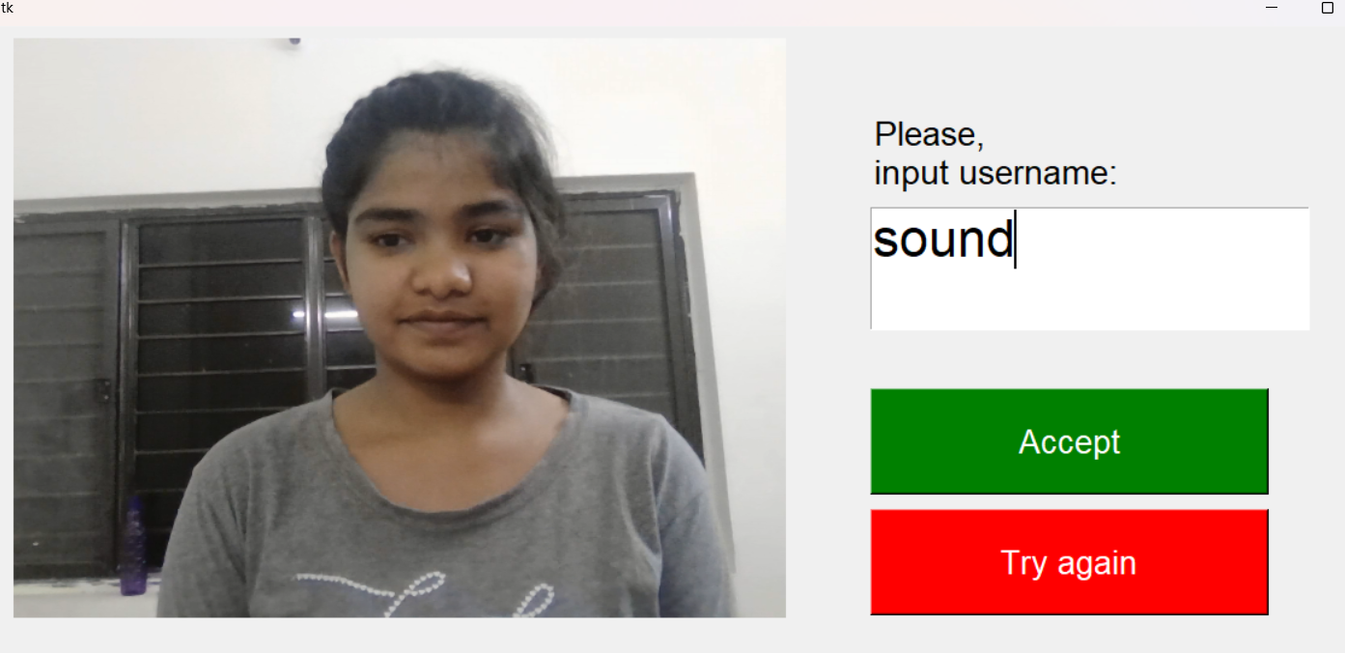
2.Registering

Slide 10
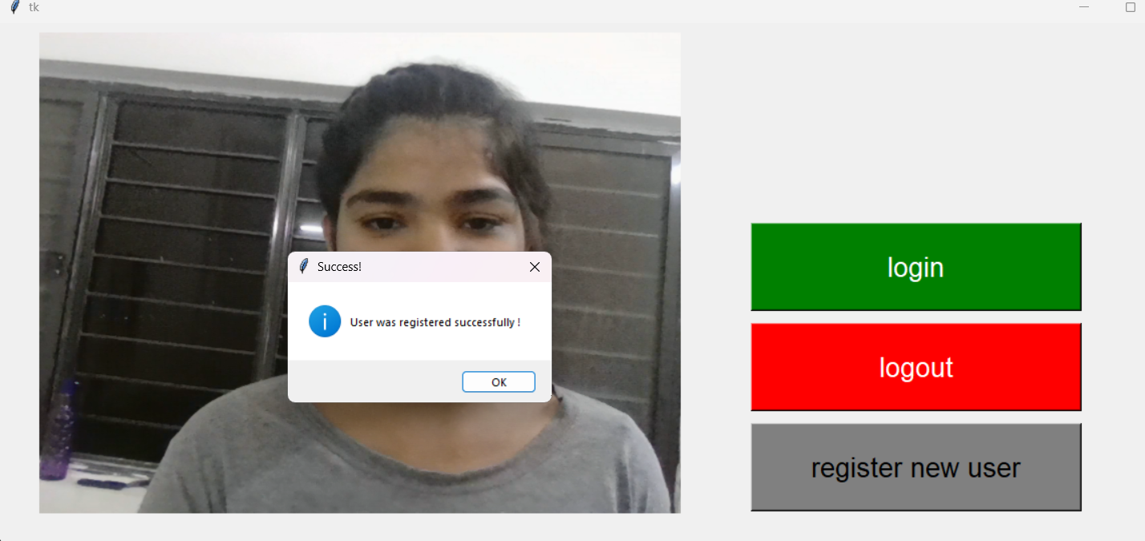
3.Complete Registering

Slide 11
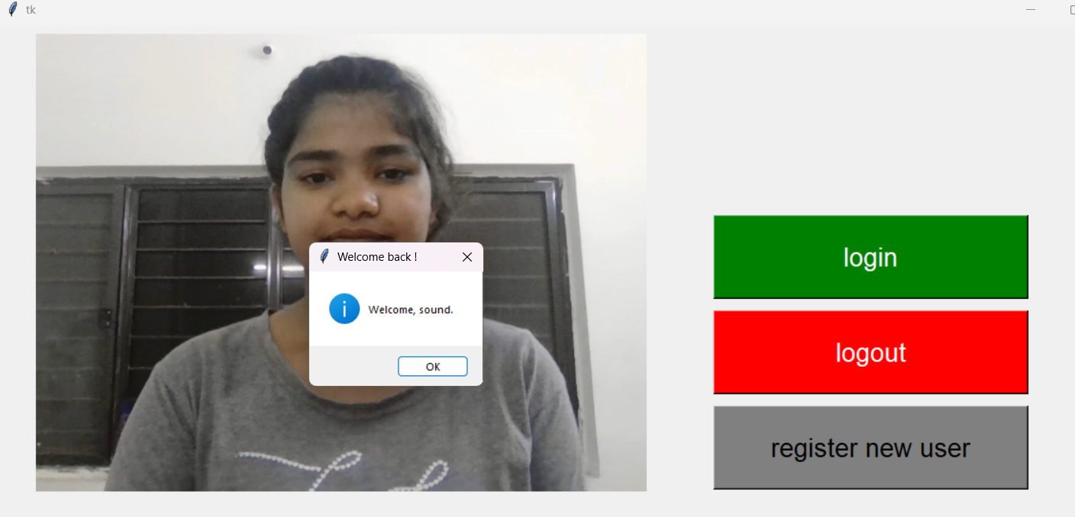
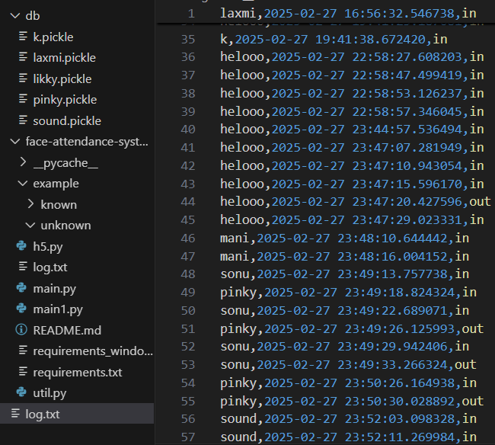
4.Login

Slide 12
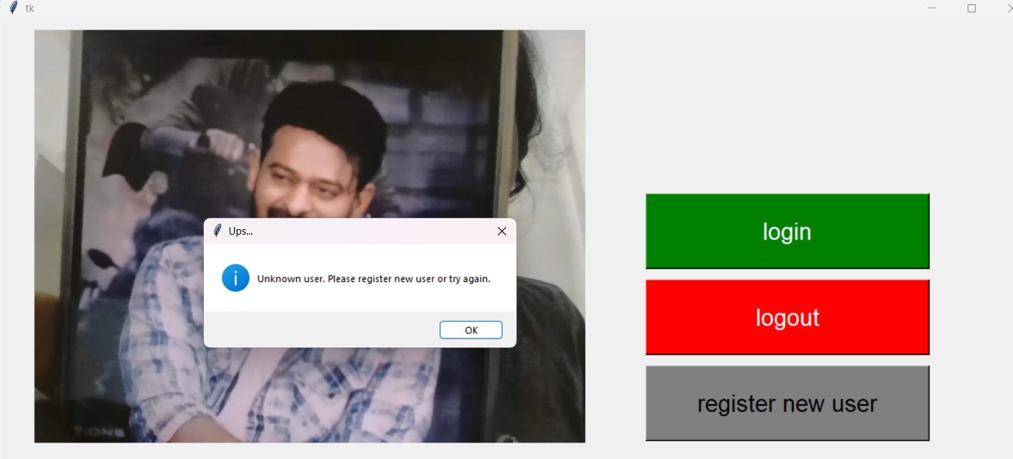
5.Unknown User

Slide 13
CONCLUSION
In conclusion, the Smart Attendance System not only streamlines attendance tracking but also fasters more interactive and accountable environment. Its innovative approach showcases the power of technology in transforming traditional processes, ultimately contributing to a more efficient and effective Educational experience. As the system continues to evolve, it holds the promise of further enhancing user engagement and operational efficiency, making it a valuable asset in any educational or professional setting.

Slide 14
FUTURE PERSPECTIVE
The Smart Attendance System using OpenCV has several promising future perspectives that can enhance its functionality, usability, and impact. Here are some potential directions for the project:
Enhanced Security Features
Scalability and Deployment
User Experience Improvements
Privacy and Compliance

Slide 15
Thank you...!
Notes:
15

